Slide 1
Project 2: Travelling Salesperson Problem
David Burchakov
Andres Vega
Pedro

Slide 2
Content
Introduction
Backtracking algorithm
Triangular approximation
Other Heuristic: Sweep Method
Analysis

Slide 3
Introduction

Slide 4

Backtracking algorithm
This algorithm considers all possible routes, creating paths node by node and only proceeds if the path is promising.
Is capable of finding the optimal (exact) solution, exhaustively searching through all possible permutations of nodes.
But it has an infeasible amount of computation time even for relatively small inputs.
Worst-case time complexity of the backtracking approach for TSP is O(n!)
shipping.csv

Slide 5


Backtracking algorithm
TSP problem is practically Hamiltonian Cycle Problem, but also requires to fine the lowest cost path among all Hamiltonian Paths.
There are multiple ways to optimize the algorithm, considering the following conditions for Hamiltonian cycle:
Must not contain Pendant nodes
Must not contain Articulation Points
stadiums.csv
tourism.csv

Slide 6
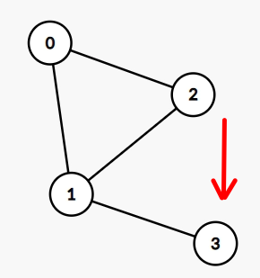
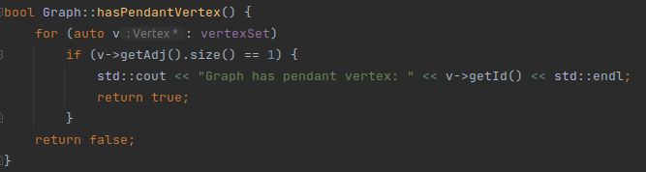
Backtracking algorithm
Pendant nodes
Pendant vertex (leaf) is a vertex with degree one.

Slide 7
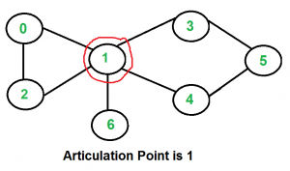
Backtracking algorithm
Articulation Point
Articulation point is a vertex that disconnects the graph if removed.
Obviously, Hamiltonian cycle is impossible if a graph contains an articulation point, as all nodes should be visited ones, and we should return to the first vertex.
Moreover, in general it is not recommended to have a graph with articulation points, because if this vertex fails the whole network becomes disconnected (fails).

Slide 8
Backtracking algorithm
Articulation Point
There are multiple algorithms to find the articulation point in a graph. One of the most efficient is Tarjan’s algorithm with linear time complexity O(V + E)

Slide 9
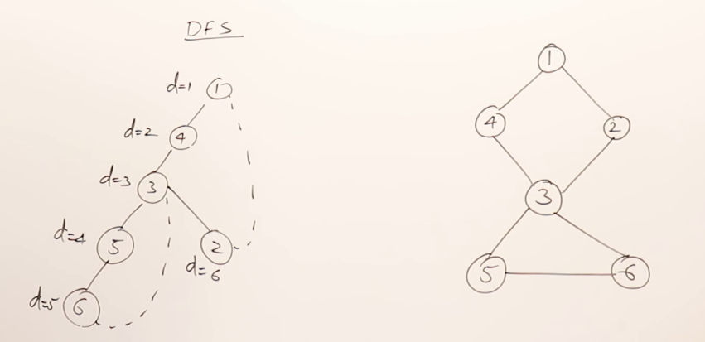
Backtracking algorithm
Tarjan’s algorithm
Steps:
Perform Depth-First Search (DFS) on the graph, initializing discovery_time[node] and low[node] for each node.
For each node u, review its children v. If low[v] < discovery_time[u], u is not an articulation point. If low[v] >= discovery_time[u] for all v, u is an articulation point.
The root of the DFS tree is an articulation point if it has two or more children.

Slide 10
Backtracking algorithm
Branch and Bound
Use Branching and Bounding optimization greatly speeds up the program’s execution.
However, this approach is still not feasible for Large graphs.

Slide 11

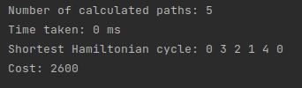

Backtracking algorithm
Plain Backtracking
Branch and Bound
stadiums.csv
tourism.csv
shipping.csv

Slide 12
Triangular approximation
This algorithm works by:
Firstly, creating a MST of the entire graph using Prim’s algorithm, considering the root the node with id=0.
Secondly, running a DFS search to give us a vector with the nodes in pre-order of the MST.
Lastly, calculating the distances between the consecutive nodes in the vector, using and adding to the final result.
NOTE: this algorithm should only be used in graphs that respect the triangular inequality, this is, c(t,v) £ c(t,u) + c(u,v) for every edge (t,v), (t,u) and (u,v) in E.

Slide 13
Prim’s Algorithm and the DFS
Even if Prim’s algorithm doesn’t need na explanation, it is important to note that during it’s execution, the children nodes will be stored in a vector “children” in the parent node, so that we can later run a recursive algoritm (DFS) to get the pre-order path.
The DFS goes like this:

Slide 14
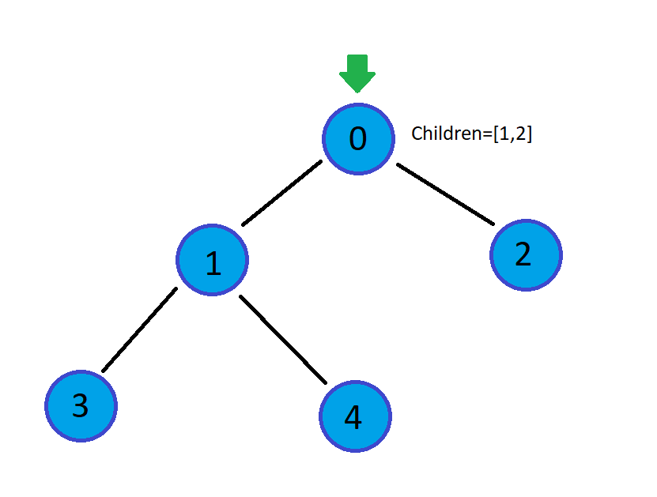

Path=[]

Slide 15
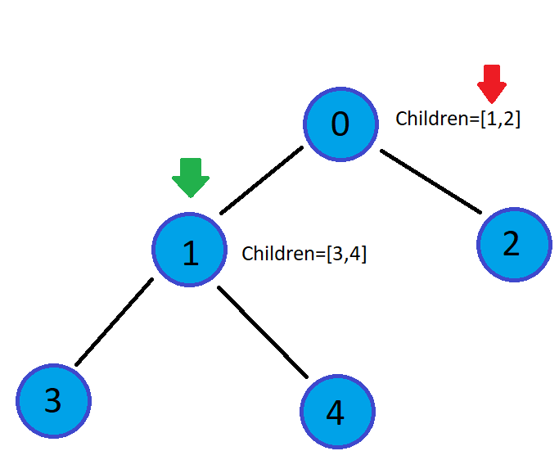
Path=[0]

Slide 16
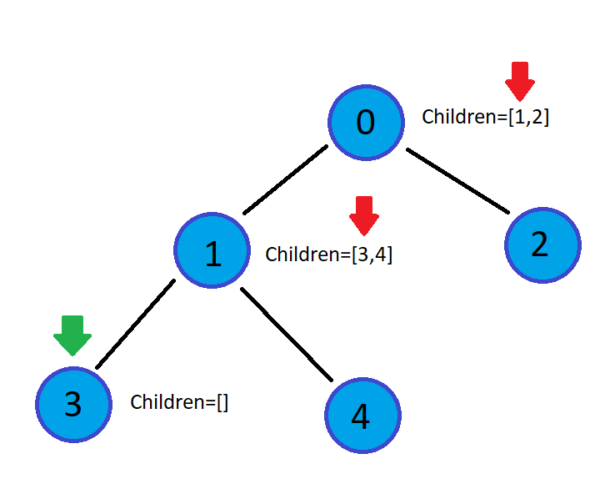


Path=[0,1]

Slide 17
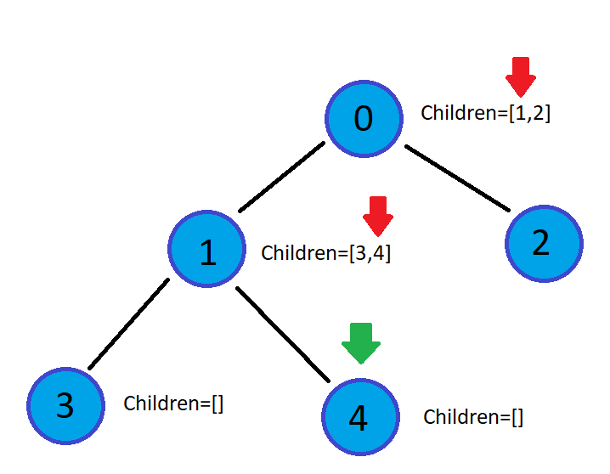
Path=[0,1,3]

Slide 18
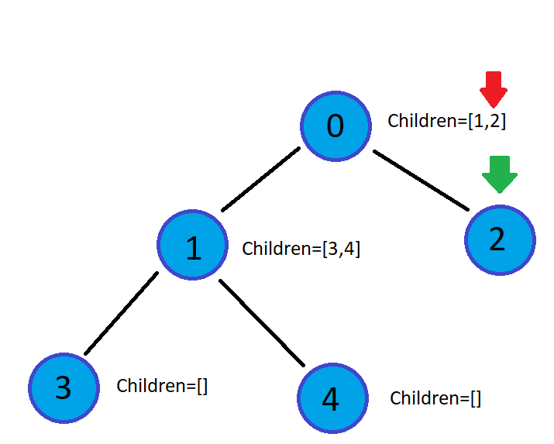

Path=[0,1,3,4]

Slide 19
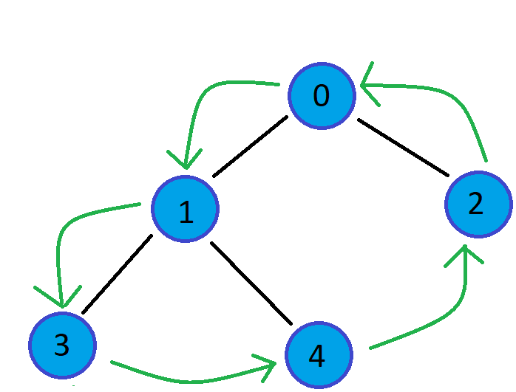
Path=[0,1,3,4,2]

Slide 20
New heuristic: Sweep method
2
This algorithm starts at any vertex and starts looking for the closest vertex to it. The closest vertex is determine using the angle between the two vertex. Once it finds the closest one, it marks itself as visited and repeats the same steps with the closest vertex until all the vertex are visited.
3
1
0
Since the algorithm has to iterate through all possible edges, the time complexity of it is O(E). It uses recursion because it calls the function to use it in the closest vertex until all vertex are visited.
5
4

Slide 21
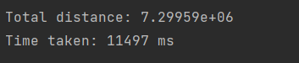
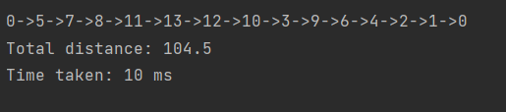
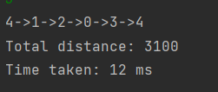

Sweep method: Performance
Real world graph
Shipping
Tourism
Stadiums

Slide 22
2
3
3
1
0
5
4
Actual Path:

Slide 23
2
3
3
1
0
5
4
Actual Path:

Slide 24
2
3
3
1
0
5
4
Actual Path:

Slide 25
2
3
3
1
0
5
4
Actual Path: 3

Slide 26
2
2
3
1
0
5
4
Actual Path: 3

Slide 27
2
2
3
1
0
5
4
Actual Path: 3

Slide 28
2
2
3
1
0
5
4
Actual Path: 3

Slide 29
2
3
1
0
0
5
4
Actual Path: 3->2

Slide 30
2
3
1
0
0
5
4
Actual Path: 3->2->0

Slide 31
2
3
1
1
0
5
4
Actual Path: 3->2->0

Slide 32
2
3
1
1
0
5
4
Actual Path: 3->2->0->1

Slide 33
2
3
1
0
5
5
4
Actual Path: 3->2->0->1

Slide 34
2
3
1
0
5
5
4
Actual Path: 3->2->0->1->5

Slide 35
2
3
1
0
5
5
4
Actual Path: 3->2->0->1->5->4

Slide 36
Problem and solution of this heuristic
After develop the heuristic we realized there are some cases where the algorithm didn’t find a path. This is because depending in the node it starts the algorithm finds a Hamiltonian cycle or not. To fix this we iterate through all the nodes and start the algorithm with all the nodes to find the ones that satisfies the desired requirements.
Since it iterates through all vertex and calls the previous heuristic, the fixed heuristic has a time complexity of O(EV).
There can be more than one vertex that gives a valid path, but this algorithm chooses the first one it finds to save time.

Slide 37
Example
2
3
Starting node | Path | Correct?
0 | 0->1->2->3->4->5 | No
1 | 1->2->3->4->5 | No
2 | 2->3->4->5->1->0->2 | Yes
3 | 3->2->0->1->5->4->3 | Yes
4 | 4->5->1->2->3 | No
5 | 5->1->2->3->4->0 | No
1
0
5
4

Slide 38
Analysis & comparison – Toy Graphs
Shipping
Method | Time (ms) | Value | Notes
Backtracking algorithm | 242 | 86.7
Sweep | 10 | 104.5 | 1,20 times the optimal and 24.2 times faster
Stadiums
Method | Time (ms) | Value | Notes
Backtracking algorithm | 71881 | 341
Sweep | 49 | 472.7 | 1,38 times the optimal and 1466,9 times faster
Tourism
Method | Time (ms) | Value | Notes
Backtracking algorithm | 1 | 2600
Sweep | 12 | 3100 | 1,19 times the optimal and 12 times slower

Slide 39
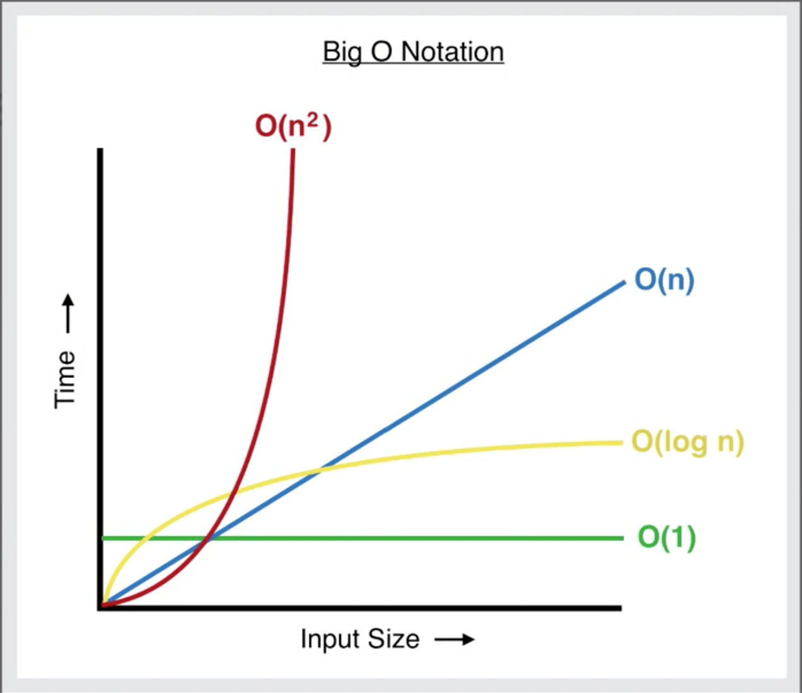
Analysis & comparison – Toy Graphs
Tourism
Method | Time (ms) | Value | Notes
Backtracking algorithm | 1 | 2600
Sweep | 12 | 3100 | 1,19 times the optimal and 12 times slower
In general, Sweep Algorithm performs much faster, but less accurate than plain Backtracking. However, we may notice that for a very small graph, the execution time of backtracking algorithm is way faster. This is due to the time complexity for small input sizes.
If we analyze the Big O Notation figure closely, we may notice, that O(n^2) is generally much more time consuming than O(log n),
However, for very small input, O(n^2) will perform better.
(Our actual time complexities are O(n!) for Backtracking and
about O(n log n) for Sweep)

Slide 40
Analysis & comparison – Real World
Graph 1
Method | Time (ms) | Value | Notes
Triangular Approximation | 674 | 1.12185e+06
Sweep | 348 | 7.09162e+06 | 7.05 times worse 1.93 times faster
Graph 2
Method | Time (ms) | Value | Notes
Triangular Approximation | 6572 | 1.872e+06
Sweep | n/a | n/a | n/a
Graph 3
Method | Time (ms) | Value | Notes
Triangular Approximation | 26412 | 2.90688e+06
Sweep | 139899 | 1.12882e+08 | 38.76 times worse 5.3 times slower

Slide 41
Conclusion
From all the algorithms, the Triangular Approximation seems to have shown the best results, being both faster and more precise then the Sweep method in the majority of cases, and it is obviously much more viable then the backtracking method.
Unfortunatly, this wasn’t the final objective, since the third heuristic should be at least faster or more precise then Triangular Approximation.
Thats why we added a FOURTH heuristic, where it comes:

Slide 42
The fourth Heuristic
Graph 1
Method | Time (ms) | Value | Notes
Triangular Approximation | 674 | 1.12185e+06
Raquel | 38 | 4.04631e+06 | 3.6 times worse 17.7 times faster
Graph 2
Method | Time (ms) | Value | Notes
Triangular Approximation | 6572 | 1.872e+06
Raquel | 481 | 1.015e+07 | 5.56 times worse 13.66 times faster
Graph 3
Method | Time (ms) | Value | Notes
Triangular Approximation | 26412 | 2.90688e+06
Raquel | 1472 | 1.32924e+07 | 4.47 times worse 17.9 times faster

